Slide 1


Prady MFI System
Prady MFI system is a web-based E.R.P system customized to assist micro-finance institutions to have a one-stop center for all operational needs

Slide 2
What you need to Know
Setup Requirements
Access Platforms
How it works
Active web-server either shared hosting or VPS
Registered Company domain or IP address.
Sender ID for bulk SMS integration
Safaricom B2C & C2B paybills for collection and disbursements.
This is a web-based system developed to work either locally hosted, shared hosting or on VPS server.
The system can be accessed on any modern browser either on phones or computers.
Security is highly enhanced by encryption mechanisms
The system supports multi-user and multi-level access controlled by assigned roles
Approvals of templates, leaves, advances, disbursements etc. requires OTP as online signature.
Multi-levels access includes HQ, regions, branch & portfolios

Slide 3





System
Modules
Loan Management
Manage your Loan-book, collection sheet & termly reports, loan statements, arrears management and clientele management.
Accounting
Chart of accounts, Ledger, TB, BL, Income statement & expenses, Petty cashbook, Requisitions and cashflows.
Payments Module
C2B & B2C Integrated, payment reports, payment statement and receipts management.
Human Resource
Employees management, Leaves management, salary advances and staff payroll.
Communication & Business Analytics
Bulk SMS and emails for Communication, PAR reports, Financial analysis, Staff targets and performance reports.

Slide 4
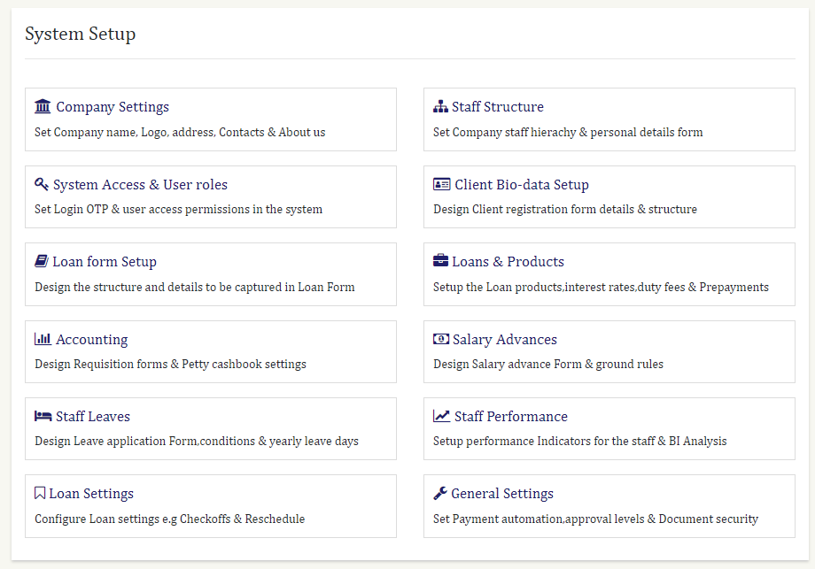
System setup Overview

Slide 5
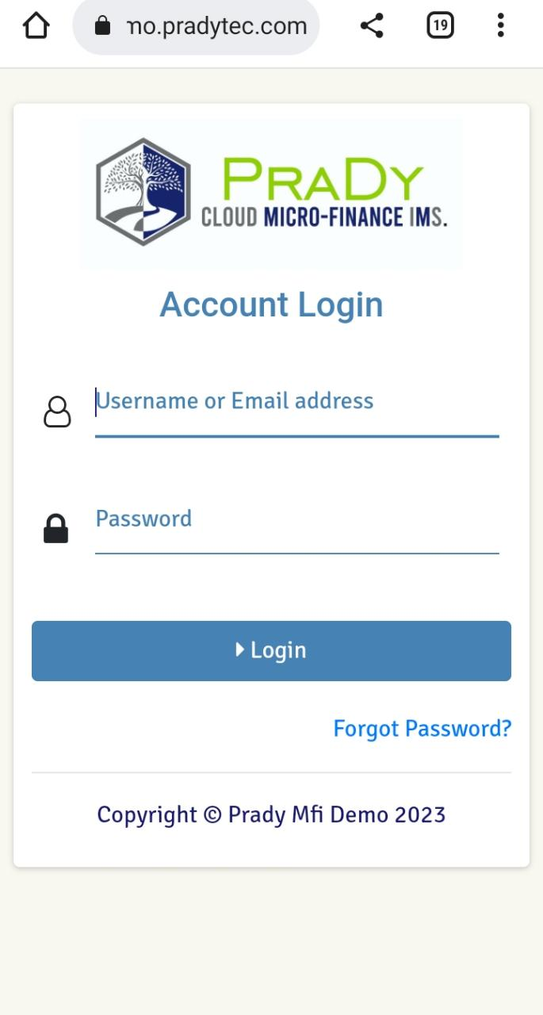
System Setup
Company Settings – sets up the company name, logo, Bulk SMS credentials and company details.
Staff structure – setup the staff biodata and KYC needed
Client biodata – Biodata to be captured on forms when creating a client profile in the system. This is linked to Loan form setup for specifying what has to be captured when creating a loan template.
Loans and products – define the type of loans you give, return interests and repayment period with the scheduled payment terms.
Accounting – Design requisition forms, accounting rules and petty cash settings.
Staff performance – Setup performance indicators and targets.

Slide 6
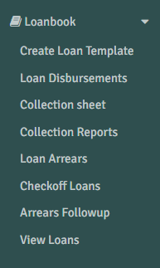
Loan Management
The system has a capability to allow users (officers in the field) to collect daily payments from clients assigned to them by the system basing on the loan schedule day. This entails the following:
Collection sheets – this is a sheet of clients to pay on a certain date basing on the system allocation from their loan schedule assigned to a certain officer.
Template management - the system allows creation of disbursement template created by the user assigned to it and sends the template to different staff levels for approval before they are disbursed.

Slide 7
Loan Management
Loan disbursements – this shows all loan templates that are either pending disbursement, pending approvals, declined or disbursed categorized by portfolio, time and branches
Collection reports – From the collection sheets, the system creates a collection report to show expected collection versus actual collected on a certain day.
Arrears & follow-up – When a client fails to make payments on time basing on the system generated schedule, they system generates arrears report showing loan cycle of client, fall-date and installment where the client stopped paying. This can be viewed at Corporate, branch and portfolio levels.

Slide 8
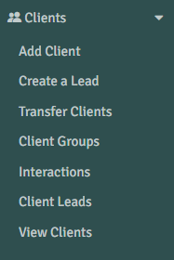
Client Management
Client management – Involves all client onboarding operations, editing of client records, suspension and other account operations. This provides a view for dormant, active and suspended clients from corporate to portfolios.
Client Leads & Interactions – The system allows creation of temporary data about client in form of leads, writing notes about interactions done with client in the field for future follow-up and accountability upon follow-ups.
Client groups – The system allows categorizing clients basing on desired features they posses like regions etc.
Transfer of clients – this entails portfolio handovers from one staff to the other during resignations.

Slide 9
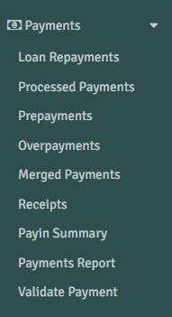
Payments Module
This module involves B2C and C2B paybills integration with Safaricom to enable loans disbursement and collection.
Payment notifications (C2B) – payments from clients reflect on real-time in the system. The system can be set to auto-approve payments or let be approved manually.
Bulk disbursements (B2C) – this is a platform to disburse loans, salary advances and requisitions.
Payments report – A comprehensive report showing breakdown of how payments have been received and effected into clients’ accounts. E.g. Principal, interest etc.
Pay-In summary – report on how C2B paybills have collected money throughout the month.

Slide 10
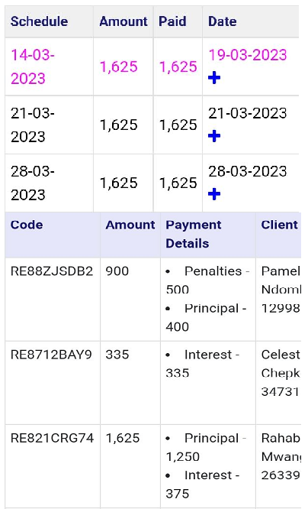
Payments Module
Schedule management- the system segments the loan amount into weekly or monthly payments basing on the type of loan applied. It also has indicators for good paid loans and bad paid loans; This shows a pink color for a delayed payment.
Payment segmentation and tracking - the system segments and separates client loan into defined payments like processing fee, interest, and principle for proper accounting on profits and returns. Payment precedence is set by the company, by default it takes principle first then others.

Slide 11
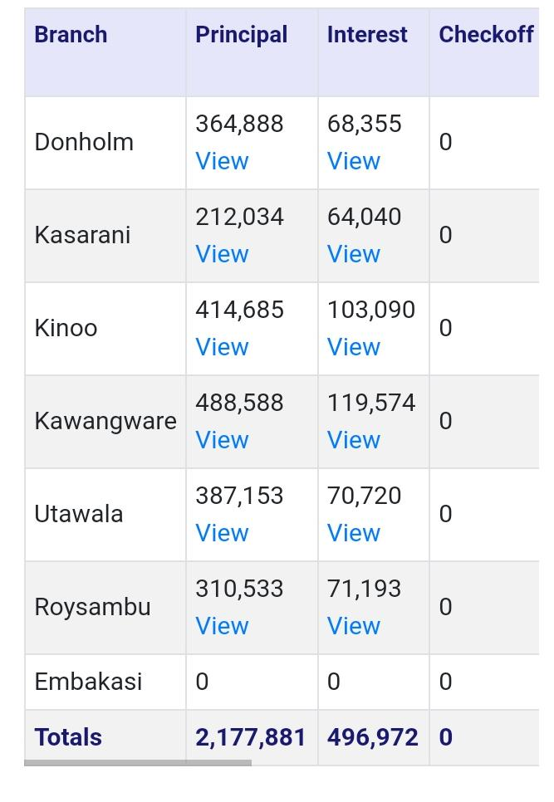
Payments Module
Payment transparency - the system documents everything upon client payments and approval by showing how the payment was segmented and if there is overpayment, it keeps for the client for future.
Payment reports and receipts - the system keeps daily payments reports on how much was collected and effected into client’s account and the monthly payment reports.
Payments validator- this allows you to search any payment transaction to show who paid the payment to Paybill, to whom was assigned and who assigned it.
Suspense account – this controls prepayments and overpayments that can be assigned later to client’s account.

Slide 12
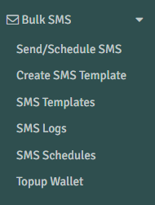
Communication Module
This majorly covers bulk SMS integrated with Safaricom and system emails used for the following functions;
Staff communication – the system allows top management to pass quick information to staff members.
Client payments reminder – from loans schedule, someone can send SMS to clients who have to pay on that day reminding them to pay their installments.
Informing clients – this gives a provision to send promotional or transactional SMS to pass information.
OTP confirmation – login OTP confirmation, template approval, leave application approval & confirmation and salary advance configurations to identify the eligibility of the process.

Slide 13
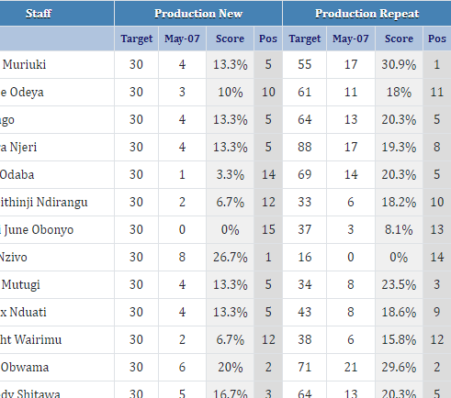
BI Analysis Module
This is the Business Intelligence analysis that analyzes all MFI operations to advice the business on red signs and the future of the business to allow management to make informed decisions.
Arrears analysis – the system analyzes arrears from HQ level, branch level and officer level showing the PAR, overdue loans and segmented days period arrears.
Client analysis – analyzes client loan cycles, active and dormant clients on each day of the month.
Portfolio analysis – analyzes the staff and branch portfolio collection each day, portfolio yields and yield gap.
Loans analysis – analyzes gross portfolio, performing clients, disbursed loans, repeat loans and new loans done in a specific period.

Slide 14
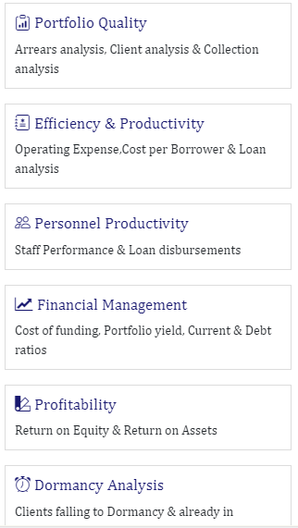
BI Analysis Module
Collection analysis – analyzes daily and monthly collection trend and gross portfolio trend per corporate, branch and portfolio level.
Financial analysis – analyzes the income of each portfolio size.
Operating expense ratio and financial self-sufficiency – this shows how current expenses trend is comparing to current incomes per branch and officer.
Personnel analysis – measures the current performance of staff and branch basing on the targets set.
Dormancy analysis – analyzes dormant clients in specific period i.e. below 7 days, 7-14 days, 14-28 days, 28-60 days and above 60 days.

Slide 15
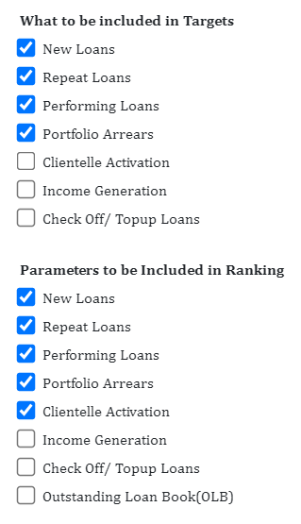
BI Analysis Module
The system allows assigned staff to create targets to portfolios and branches. These targets form the basis for analysis and rewards to staff. The following can be set as targets for individual portfolios per month;
  New Loans targets
  Repeat Loans targets
  Performing clients targets
  Arrears collection targets
  Clientele activation targets
  Income generation

Slide 16
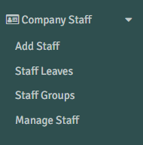
HR Module
This covers all staff operations from staff onboarding to other human resource functions including the following;
Staff leaves – incorporates leave days award by the system basing on settings, leave application and approvals
Staff groups – this allows creation of ranks and positions according to company hierarchy.
Salary advances – application and approval of salary advance that will reflect in payroll of that month.
Payroll – Integrated with up-to-date KRA, NHIF an NSSF deduction formulas to allow preparation of staff PAYE and payables. This is linked to accounting module.

Slide 17
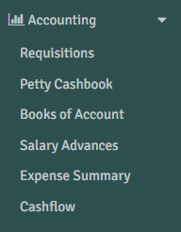
Accounting Module
This is the core system architecture that covers the following:
Requisitions done at branch or HQ level to accounting desk for approvals or disbursements.
Petty cash management from branch postings
Expected cash flows and expenses
Account books management
Accruals and accounting reports
Ledger and accounts documentation
Company expenses
Company assets
Budget preparation and management

Slide 18
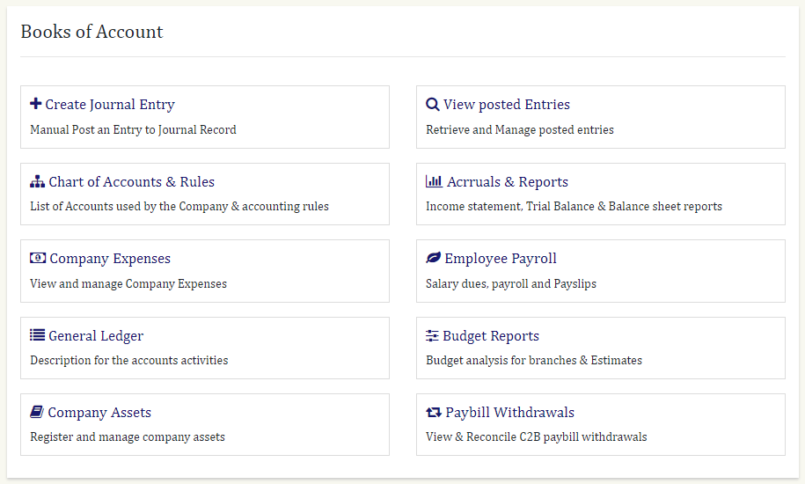
Accounting Overview

Slide 19

Why System
Having a robust system will assist your company keep correct and up to-date records that will help you actualize financial growth.
Having a real-time system on disbursements and collections increases accountability and trust since this will close all loopholes in loan manipulation and frauds.
Through business analytics, you will be able to boost your income through data analysis and in making informed decision from your operations.

Slide 20

Thank you
Reach to us via:
+254 722 295 194
+254 706 719 045
info@pradytec.com

